Slide 1

Eye For Blind
Deep Learning
Image Captioning
By:
Raghad alnasser
Shaima Alzahrani

Slide 2
Eye For Blind
Introduction :
Goal :
The project, "Eye for Blind," aims to create a deep learning model that can explain the content of an image in the form of speech through caption generation with the attention mechanism on the Flickr8K data set
>
It aims to use text to speech conversion in order to showcase our result in an audio format, thus, allowing us to recognize the objects and explain them accordingly in an audible manner.

Slide 3





Tools
powerpoint
gitHub
python
Libraries
Jupyter
Challenges
upload Zip folder
Long time run

Slide 4
Work flow
01
02
03
Data Understanding
Pre-Processing
Create the train & test data
04
05
Caption to Audio generation
Building & Evaluation
The Model

Slide 5
Dataset
8091
Images
Flicker8k
Dataset
From: kaggle
40455
Captions

Slide 6
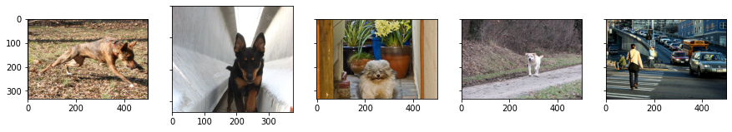
Data Understanding

Slide 7
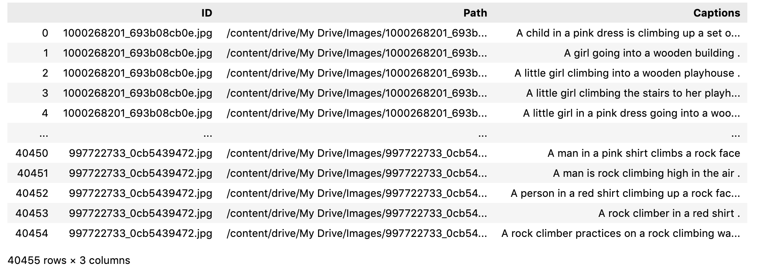
Data Understanding
Data frame summarizes the image, path & captions

Slide 8
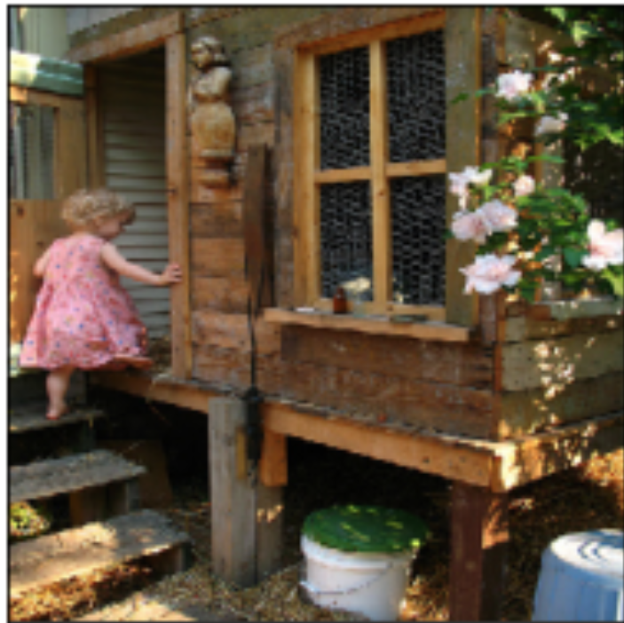
Data Understanding
Picture & their captions
1
A little girl in a pink dress going into a wooden cabin
2
A little girl climbing the stairs to her playhouse
3
A little girl climbing into a wooden playhouse
4
A girl going into a wooden building
Risk assessment
5
A child in a pink dress is climbing up a set of stairs in an entry way

Slide 9
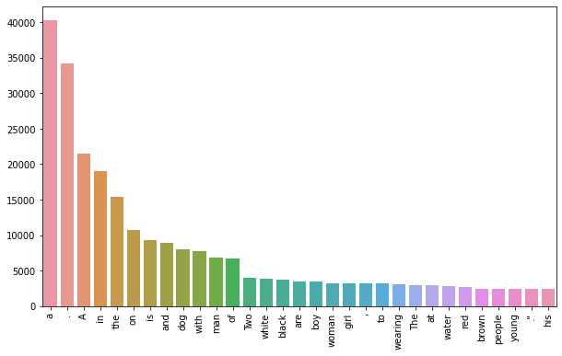
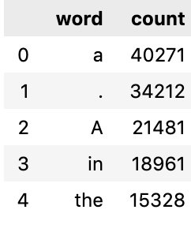
Top 30 occurring words in the captions
the counter for the captions

Slide 10
Pre-Processing
For captions
For Images
01 | Create the tokenized vectors by tokenizing the captions
02 | Replace all other words with the unknown token "UNK"
03 | Create word-to-index and index-to-word mappings.
04 | Pad all sequences to be the same length as the longest one.
01 | Resize them into the shape of (299, 299)
02 | Normalize the image within the range of -1 to 1

Slide 11
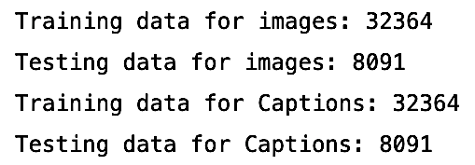
train & test split
04
The shape of each caption in the dataset after building should be ( max length)
03
The shape of each image in the dataset after building should be (299, 299, 3)
02
Make sure have done Shuffle and batch while building the dataset
01
Combine both images & captions to create the train & test dataset

Slide 12
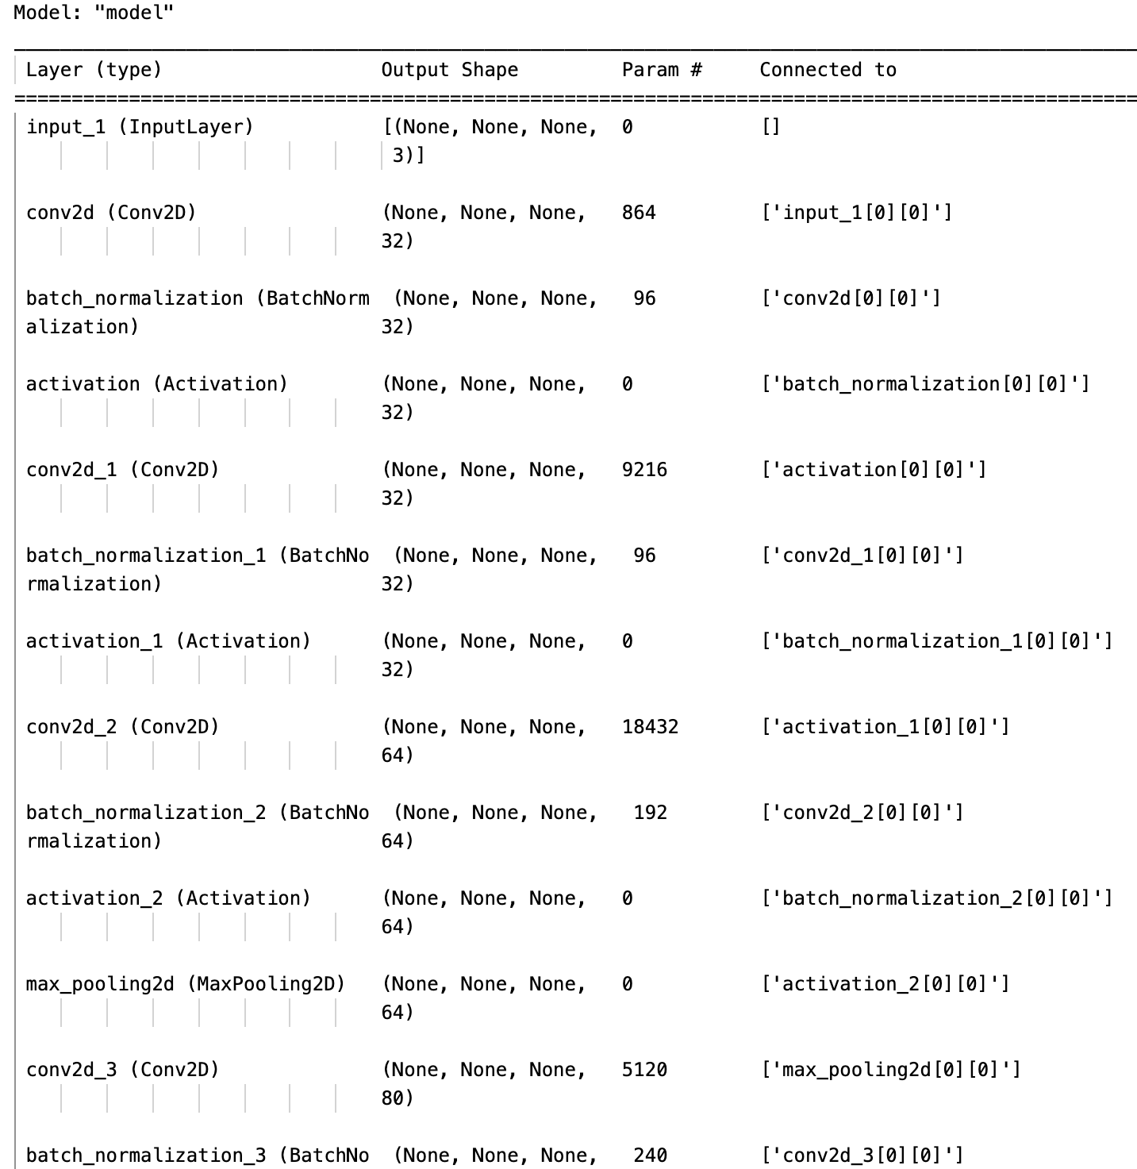
feature extraction (Model summary)
Create an instance of the Inception-v3 model from the local pre-trained
Output of this layer is 8x8x2048.
Epoch = 9
Batch size = 32

Slide 13
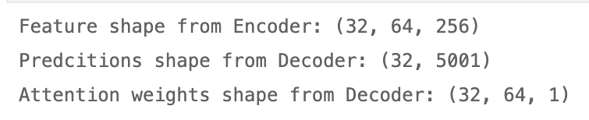
Model Building
Encoder
Attention Model
Decoder
decoded by an RNN model
The features of an image extracted by the CNN-based encoder

Slide 14
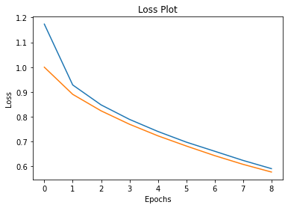
Model training & optimization
Loss for the test dataset

Slide 15
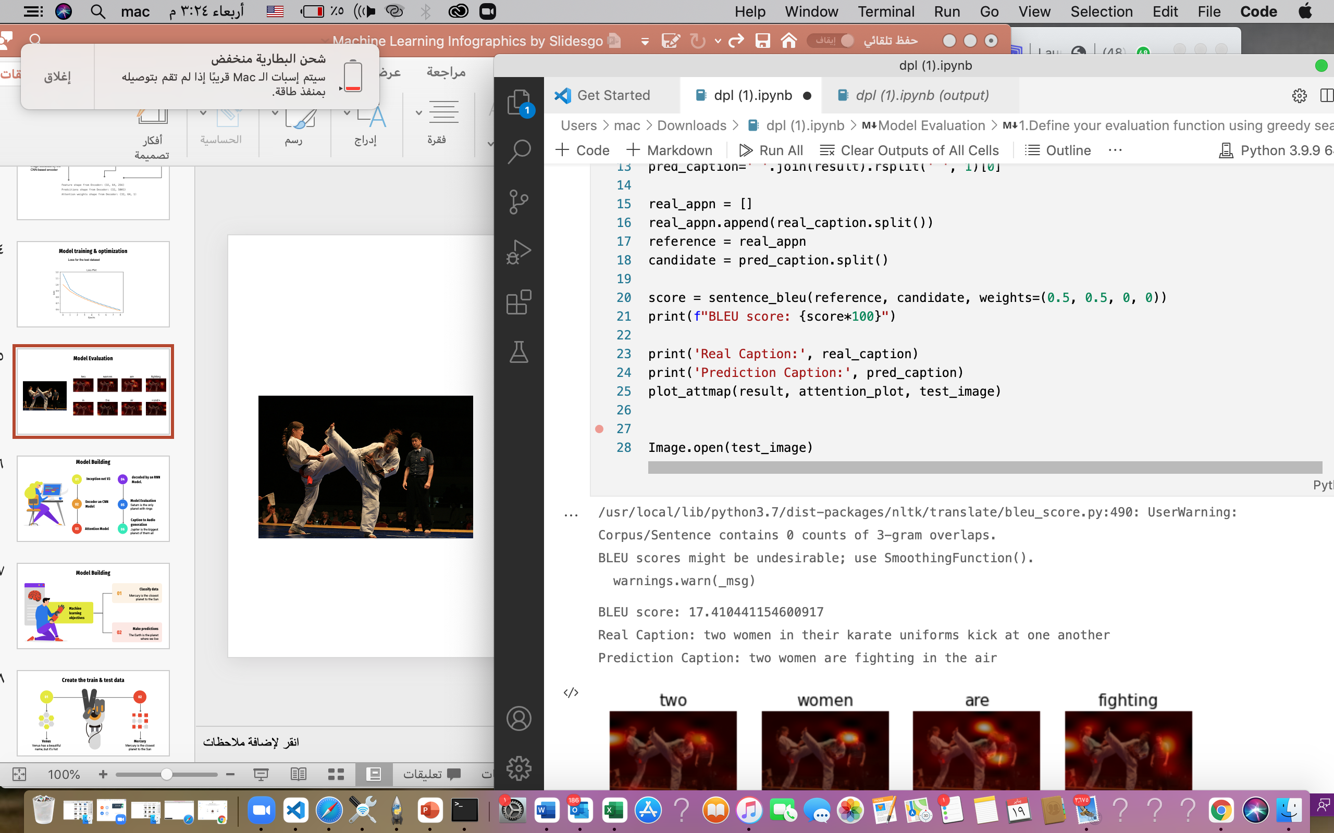
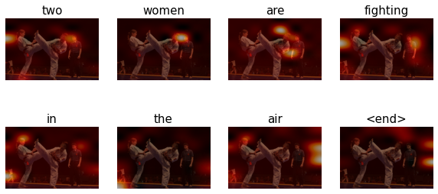
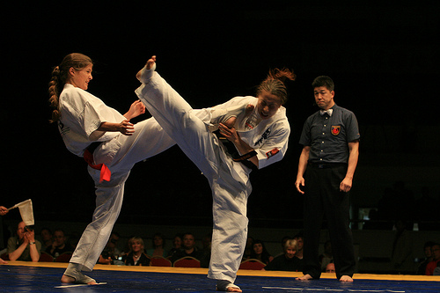
Model Evaluation

Slide 16

Caption to Audio generation
Output
Outputs
Predicted Caption
By using beam search

Slide 17
Future work : create an application to help blind people explain the pictures accordingly in an audible manner.
Thank You
Any Question ?

